Slide 1
APPLIED MACHINE LEARNING
Mortality Prediction in Patients with AKI
Linda Wa Nciko

Slide 2
TABLE OF CONTENTS
01
03
05
CONCLUSION
INTRODUCTION
DATA ENGINEERING
04
02
MODELING
DATA PREPROCESSING

Slide 3
INTRODUCTION
01

Slide 4
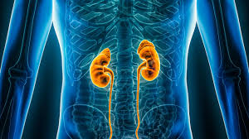
OBJECTIVE
To predict in-hospital mortality in the ICU of a retrospective
cohort of patients with AKI.

Slide 5
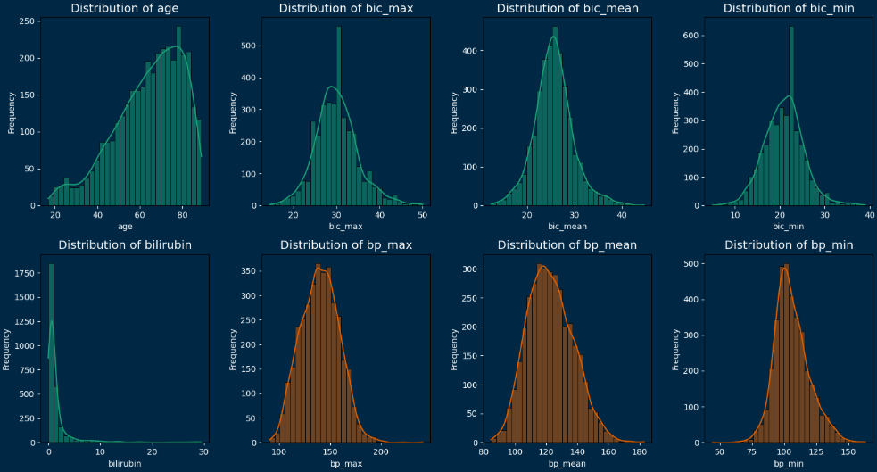
Distribution of Key Variables

Slide 6
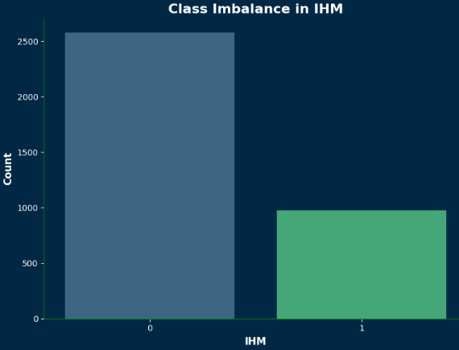
Target Variable

Slide 7
DATA PREPARATION PIPELINE
PaO2/FiO2 ratio
Mean arterial pressure
Variability in vital signs
Median
Smote
Undersampling vs Oversampling
Handling Missing Values
03. Class Balancing
05. Feature Engineering
02. Outlier Detection and Handling
04. Scaling Numerical Features
Clipping vs Remove Strategy
Clinical Ranges
3 * std
Standard Scaler
Notes:
'temp': (25, 43),
'hr_mean': (20, 200),
'bp_mean': (40, 250),
'gcs_mean': (3, 15),
'bilirubin': (0, 30),
mg/dL 'wbc_mean': (0, 100)

Slide 8
FEATURE ENGINEERING
PaO2/FiO2 ratio
Mean Arterial Pressure (MAP): MAP
Variability metrics
Evaluating respiratory failure
Understanding blood flow and blood pressure.
Blood pressure ,Temperature and heart rate

Slide 9
MODELING

Slide 10
ENSEMBLE MODELS
param_grids = {
'Random Forest': {'n_estimators': [50, 100, 200],
'max_depth': [None, 10, 20]},
'Gradient Boosting': {'n_estimators': [50, 100],
'learning_rate': [0.1, 0.01]},
'Logistic Regression': {'C': [0.1, 1, 10]},
'XGBoost': {
'n_estimators': [50, 100],
'learning_rate': [0.1, 0.01],
'max_depth': [3, 5, 7],
'subsample': [0.8, 1.0]
}
Best Model(XGBoost Regularized)
xgb_model_regularized = XGBClassifier(
n_estimators=100,
max_depth=3,
learning_rate=0.1,
lambda_=1, # L2 regularization strength
alpha=0.8, # L1 regularization strength
subsample=0.8,
random_state=42,
use_label_encoder=False,
eval_metric='logloss'
)
XGBoost Regularized Evaluation Performance
Train F1-Score: 0.9200
Test F1-Score: 0.8860
Train AUC-ROC: 0.9789
Test AUC-ROC: 0.9571

Slide 11
DEEP LEARNING

Slide 12
Fully Connected Feedforward Neural Network (FNN)
param_grid = {
'optimizer': ['adam', 'sgd'],
'dropout_rate': [0.0, 0.3],
'units': [64, 128],
'batch_size': [32, 64],
'epochs': [50, 100],
'architecture': ['simple', 'deep', 'wider']}
Best Parameters: {'optimizer': 'adam', 'dropout_rate': 0.3,
'units': 128,
'batch_size': 32,
'epochs': 100, 'architecture': 'wider'}
Evaluation Results
AUC-ROC 0.901089
F1-score 0.903226

Slide 13
Stacking
Developed a custom model through stacking the best base model(XGBOOST) and the best FNN Parameters
XGBOOST + FNN Model
Results
Improved Performance
Well Regularized
Flexibility to add more models
Stacked Model Performance
Train AUC-ROC: 0.9502
Test AUC-ROC: 0.9599
Train F1-Score: 0.8846
Test F1-Score: 0.8987

Slide 14
Insights
Regularized XGBoost performed well but still struggled with generalization
Sequential Neural net had a high F1-score but struggled with AUC-ROC
Stacking the models improved both the performance and Generalization

Slide 15
CHALLENGES
Limited Computing Resources
Working in Different Time Zones

Slide 16
PROJECT SCHEDULE
PROBLEM UNDERSTANDING AND EDA
DATA MODELLING
WEEK 02
WEEK 04
WEEK 01
WEEK 03
DATA ENGINEERING
MODEL EVALUATION AND CONCLUSION

Slide 17
OUR DOMAIN EXPERTS
Dr. Anne Mwirigi
Dr. Eugine Onyango
Neurosurgeon
Aga Khan Hospital Nairobi
Internal Medicine and Pediatrics
Kenyatta National Hospital

